Slide 1
Introduction to Accessibility Building Inclusion through Digital Accessibility Series
Julia Remsik Larsen (she/her) & Ash Mitchell (they/them)

Slide 2
Learning Objectives
Define digital accessibility
Explain how accessibility positively impacts all students
Identify common accessibility features
Develop a plan for how to approach making your course accessible

Slide 3

What is Accessibility?
Providing equitable access for all students
What are examples of accessibility in the classroom?
Physical Accessibility
Digital Accessibility (applies to both online and face to face classes)

Slide 4


What if being tall was considered a disability?

Slide 5
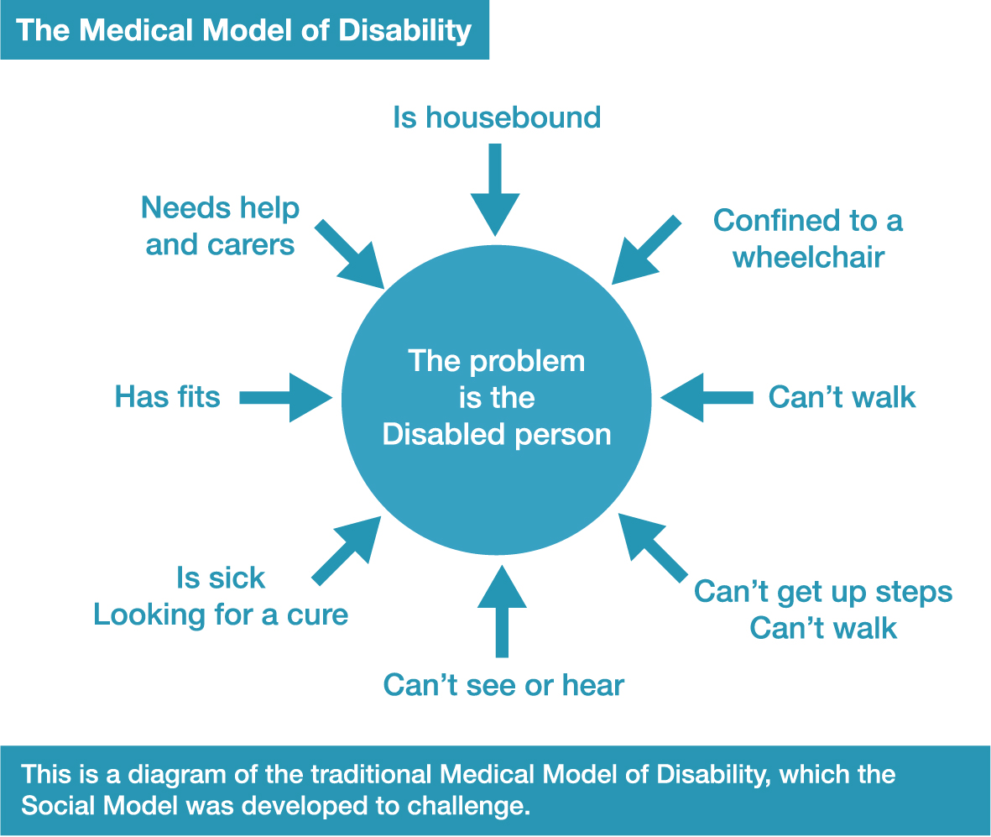
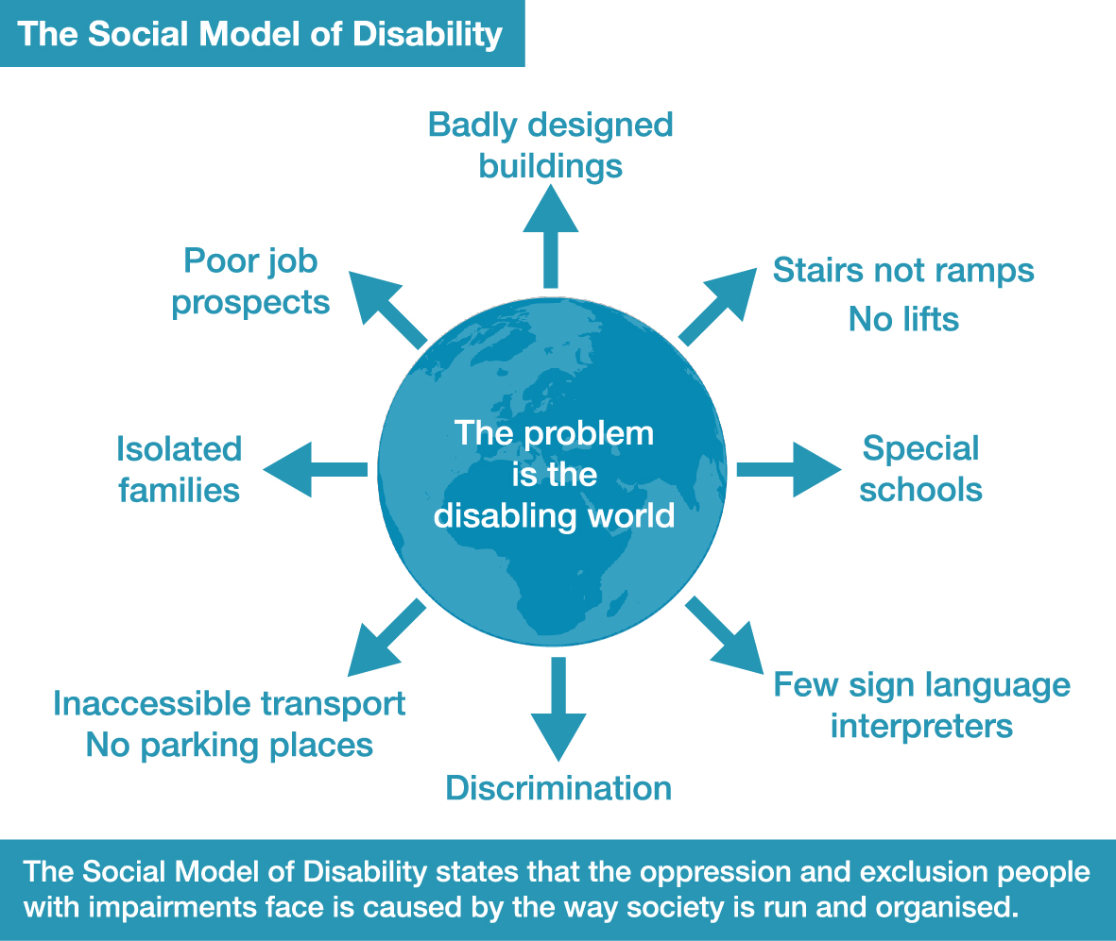
Cultural Models of Disability

Slide 6

Why Do I Need to Make My Digital Materials Accessible?
Increases student learning and success for most students
Promotes the UNL value of “Every person and every interaction matters”
Can save instructors time in the long run by reducing the need for providing accommodations
Over 20% of college students have a disability and rates are increasing (National Center for Education Statistics, 2023)
Meets the educational needs of the over two-thirds of students with disabilities who do not receive accommodations (National Center for Education Statistics, 2022)
Supports students’ civil and human rights
It is the law

Slide 7

Student Learning & Success
Digital accessible strategies can improve learning for a variety of students
For example, providing captions to videos improves exam performance 10% (Whitney & Dallas, 2019)
Removes barriers to learning for a variety of students
Could improve student retention (Tobin & Behling, 2018)

Slide 8

“Every Person & Every Interaction Matters”
N2025 Strategic Plan
Furthers President Gold’s goals of:
Extraordinary teaching and learning
Extraordinary culture and environment

Slide 9

Save Instructors Time
Individual accommodations need to be implemented quickly and can be time consuming
When material is accessible, fewer accommodations are needed
Making material accessible can be time consuming, but that time will be saved in the long run

Slide 10

Large & Growing Number of Disabled Students
Over 1 in 5 undergraduate students
Over 1 in 10 post baccalaureate students
Approximately 3.9 million total college students
(National Center for Education Statistics, 2023)

Slide 11
Increasing Rates of College Students with Disabilities Over Time
National Center for Education Statistics, 2023

Slide 12
Accommodations Alone Are Not Enough
Focus on accessibility instead of accommodation
15% of students registered with disabilities offices do not receive accommodations (National Center for Education Statistics, 2022)
Notes:
Julia

Slide 13

Why Might A Student Not Get Accommodations?
Avoiding stigma
Lengthy process
Financially expensive
Unaware that they have a disability

Slide 14

Students’ Civil & Human Rights
Right to an equitable education
Separate is not equal

Slide 15

It is the Law
ADA Title II Final Rule
On April 24, 2024, the U.S. Attorney General signed a final rule containing new regulations about digital accessibility
All digital materials (including web and mobile) need to be accessible
Must meet Web Content Accessibility Guidelines (WCAG) 2.1 AA Criteria
Deadline of April 24, 2026

Slide 16
How does the Final Rule impact UNL?
Digital materials includes...
Canvas content
Documents and files
Media (video and audio)
Textbooks and third-party software
Websites
Apps
Social media
Materials cannot be made available until guidelines are fully met
Includes materials from 3rd party vendors/websites

Slide 17
How Do I Approach Making My Courses Accessible?

Slide 18
Step 1: Learn to Make Documents Accessible
Resources
Accessibility checklist
Digital accessibility and UDL Instructor Resource
CTT Accessibility and Universal Design for Learning webpage
New ADA Title II Rule
Online Asynchronous Trainings
Digital accessibility training
Title II training
Workshops
B is for Barriers
Building Inclusion through Digital Accessibility Workshop Series
Individual Help
Digital Accessibility office hours
Building Inclusion through Digital Accessibility Series practice sessions
Contact your instructional designer

Slide 19
What are 1-2 resources that you would want to explore first?

Slide 20

Step 2: Utilize accessibility features when creating new or remediating old content
When creating a new document, make it accessible from the start
Use accessible templates or create your own
Remediate old content
Accessibility Checker
Use accessibility features (LISTS)

Slide 21
Checking for Accessibility
Use Accessibility Checkers
Will only catch some issues, so also do a manual check
Use the Desktop app rather than the online version
Access the checker under the review tab or at icon at the bottom of the screen for most programs
Use the Accessibility Checklist

Slide 22
Common Accessibility Features
5 types of accessibility features (LISTS)
Links
Images
Structure
Tables
Supplements

Slide 23

Links
What are accessible links?
Hyperlinked, embedded in the text, and explains what you are linking to
Example: Use an Accessibility checklist to see if a document is accessible.
How a screen reader reads a URL
Why are they important?
Reduce cognitive load
Gives more information if a link is broken
Gives equivalent access to people who are visually impaired

Slide 24

Images
What are accessible images?
Have alt-text and/or longer description
Example: Use this diagram to answer the following questions about the Pythagorean Theorem:
Why are they important?
Helpful if image does not load correctly
Gives equivalent access to people who are visually impaired

Slide 25
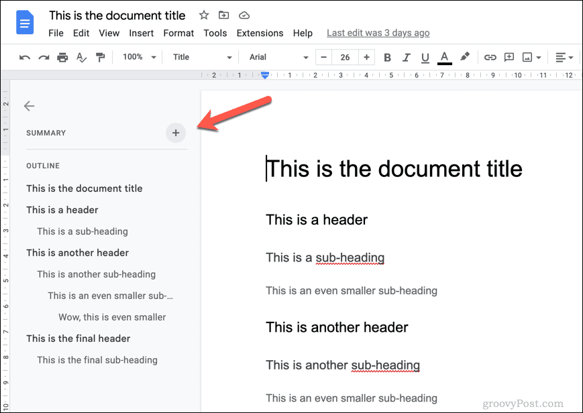
Structure
What is accessible structure?
Creating document structure via non-visual means
Use of headers and lists
Why is it important?
Allows people to easily search documents
Reduces cognitive load
Gives equivalent access to people who are visually impaired

Slide 26
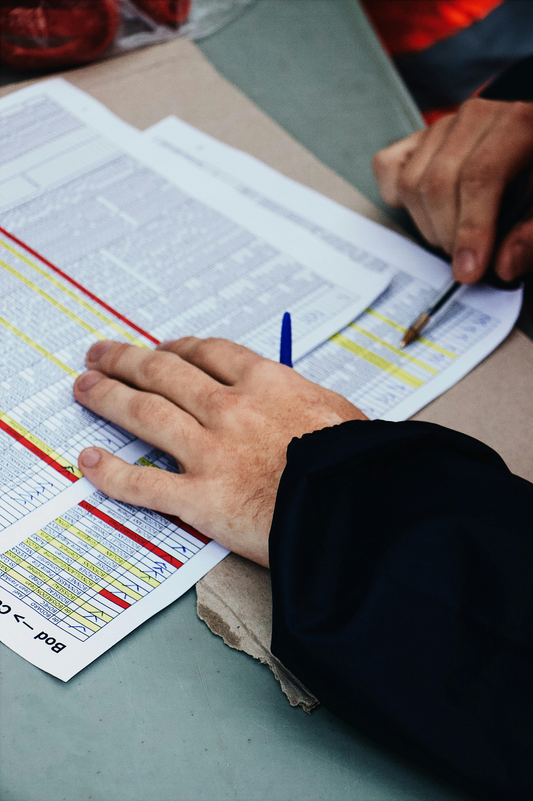
Tables
What are accessible tables?
Used to organize relational data, not for visual formatting
Contains titles, headers, and captions
Avoids merged or empty cells
Why are they important?
Gives equivalent access to people who are visually impaired

Slide 27
Supplements
What are other features that improve accessibility?
Editable document
Color contrast
Does not rely on visual formatting
Use of sans serif fonts
Save documents in the original file type (instead of a PDF)
Includes captions or transcripts for audio & video files
Why are they important?
Make documents easier to read
Reduces cognitive load
Gives equivalent access to people who are visually and/or hearing impaired
Saves you time!

Slide 28
What are 1-2 accessibility features that you think might come up the most in your courses?

Slide 29
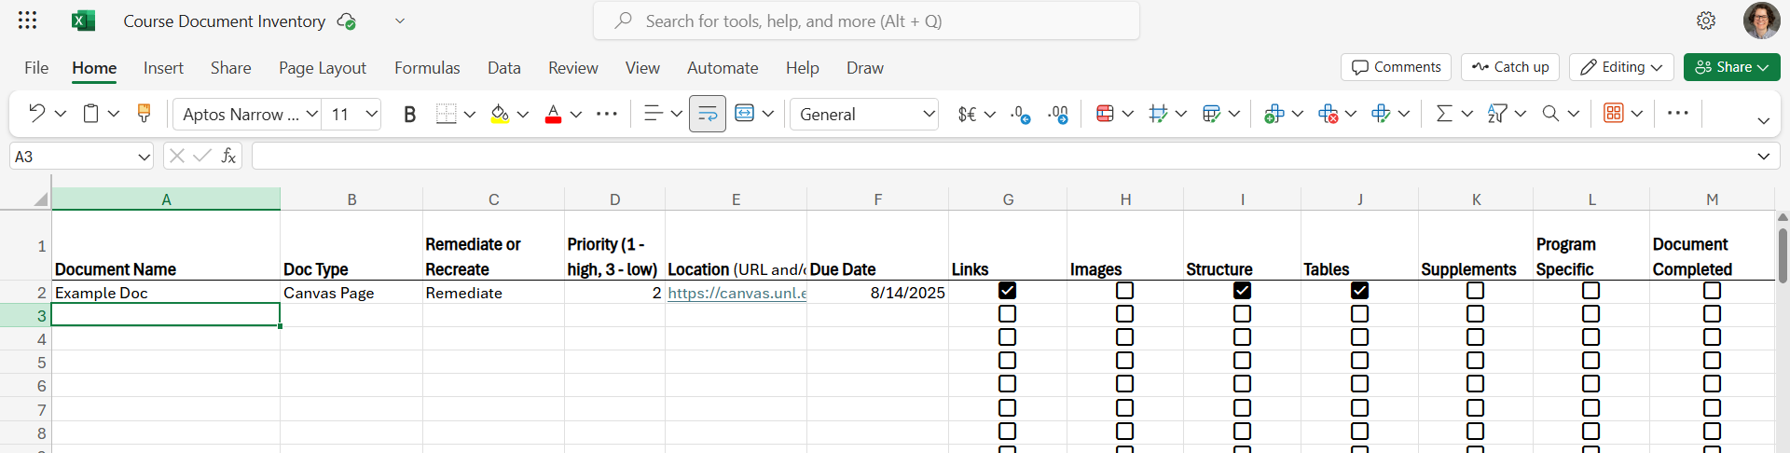
Step 3: Make an inventory of changes to be made
Course inventory template

Slide 30
Enter your syllabus in the course inventory. Then, look at the materials in you course and see which file type is most common.

Slide 31
Step 4: Make an Implementation Plan
Small bites
Schedule 20 minutes a day or 1.5 hours a week to work on accessibility
Protect this time on your schedule
Big break
Dedicate a large block of time to work on accessibility
Set deadlines, giving yourself a little more time than you think you will need
Take frequent breaks

Slide 32
Implementation Plan Tips
Will you fix documents of the same type all at once or start from the beginning of the course and go in order?
Set realistic deadlines
Set an aspirational deadline and the final deadline if that is helpful
Consider what time management strategies will work best for you

Slide 33
Do you want to use the small bites, big breaks, or other method? What else might you want to include in your implementation plan?

Slide 34

Step 5: Implement your plan and adjust as needed
Get support
Find an accountability partner or group
Check ins to track each other's progress
Co-working
Asking questions about accessibility
Work with your instructional designer
Getting questions answered
Making adjustments to your implementation plan
If you can’t complete it all, do as much as you can. Every bit helps!

Slide 35
What roadblocks do you anticipate running into? How could you address them?

Slide 36
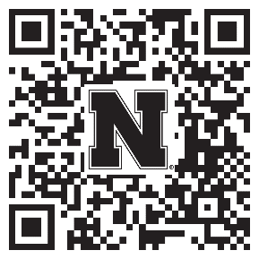
Help Strengthen Student Success At UNL!
Participate in a research study examining:
The accessibility of digital course materials in Canvas
How they impact students
Anyone teaching a credit-bearing course at UNL can participate
Conducted by the Center for Transformative Teaching (CTT)
To sign up: go.unl.edu/coursedesignstudy
Unsure? Questions? Contact amitchell22@unl.edu or aort@unl.edu

Slide 37
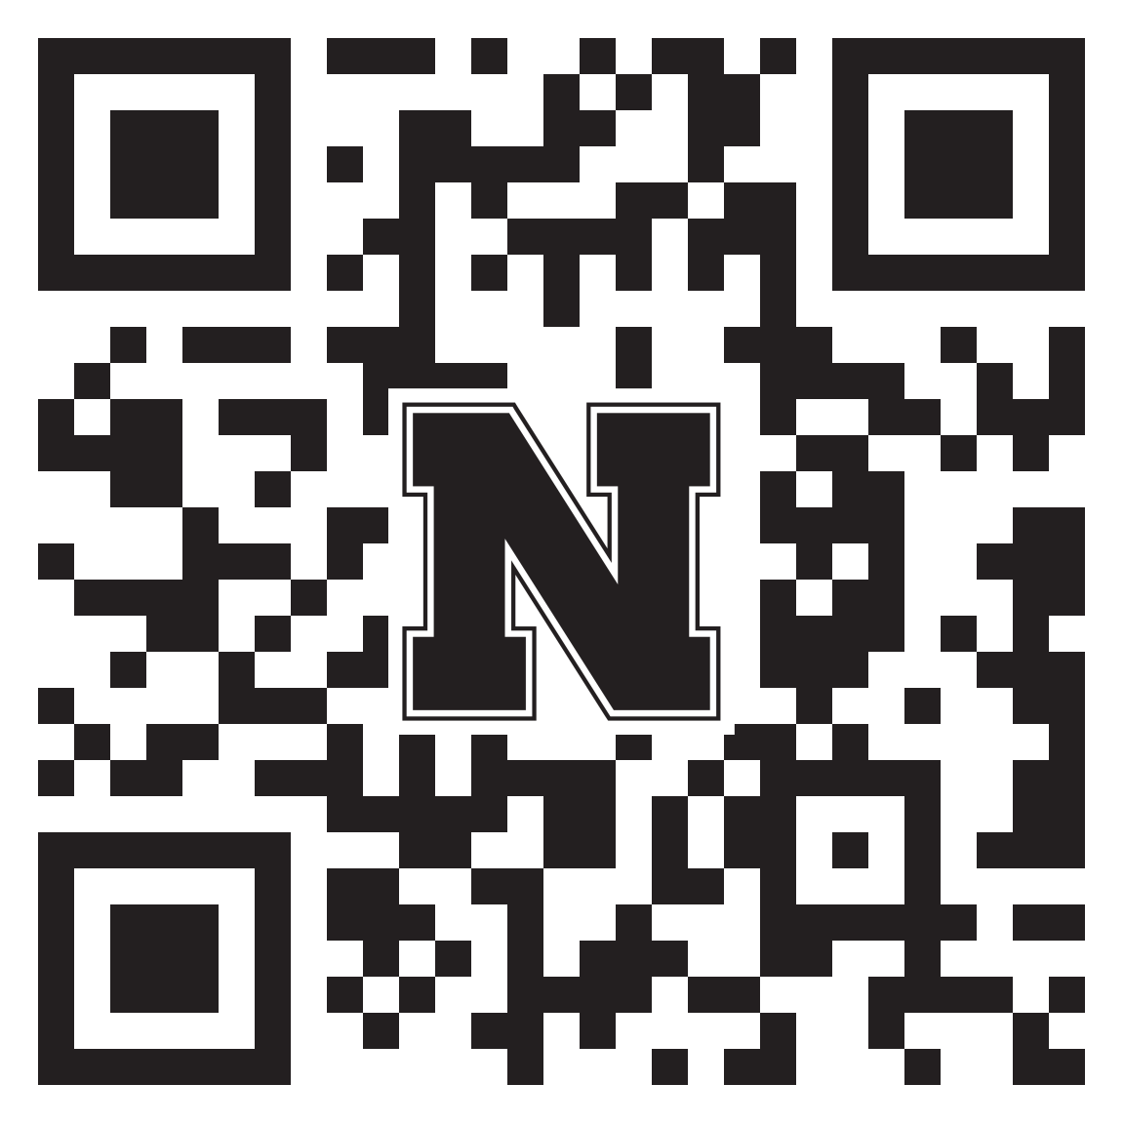
How did we do?
Your feedback is appreciated!
Please take a moment to fill out a short evaluation survey for this workshop:
https://go.unl.edu/fubn

